Slide 1





Meet the Team
Prad Mandal
Tejsai Tagore
Pavan Khiani
Yale Wang

Slide 2
PROBLEM SCOPE
EasyScotia targets persons aged 50 and above that lack proficiency with online financial service platforms
A “Fintech Over 50” report says “Many fintech solutions are designed for younger users and don’t address the needs of users over 50 properly.”
Research has demonstrated the existence of a grey divide, where older adults are less involved and skilled in digital media than the youth.
Technophobia is the most common reason for grey divide.
33%
of seniors have traditionally never banked online and availed digital finance services.
15%
lack confidence in modern banking technologies.

Slide 3

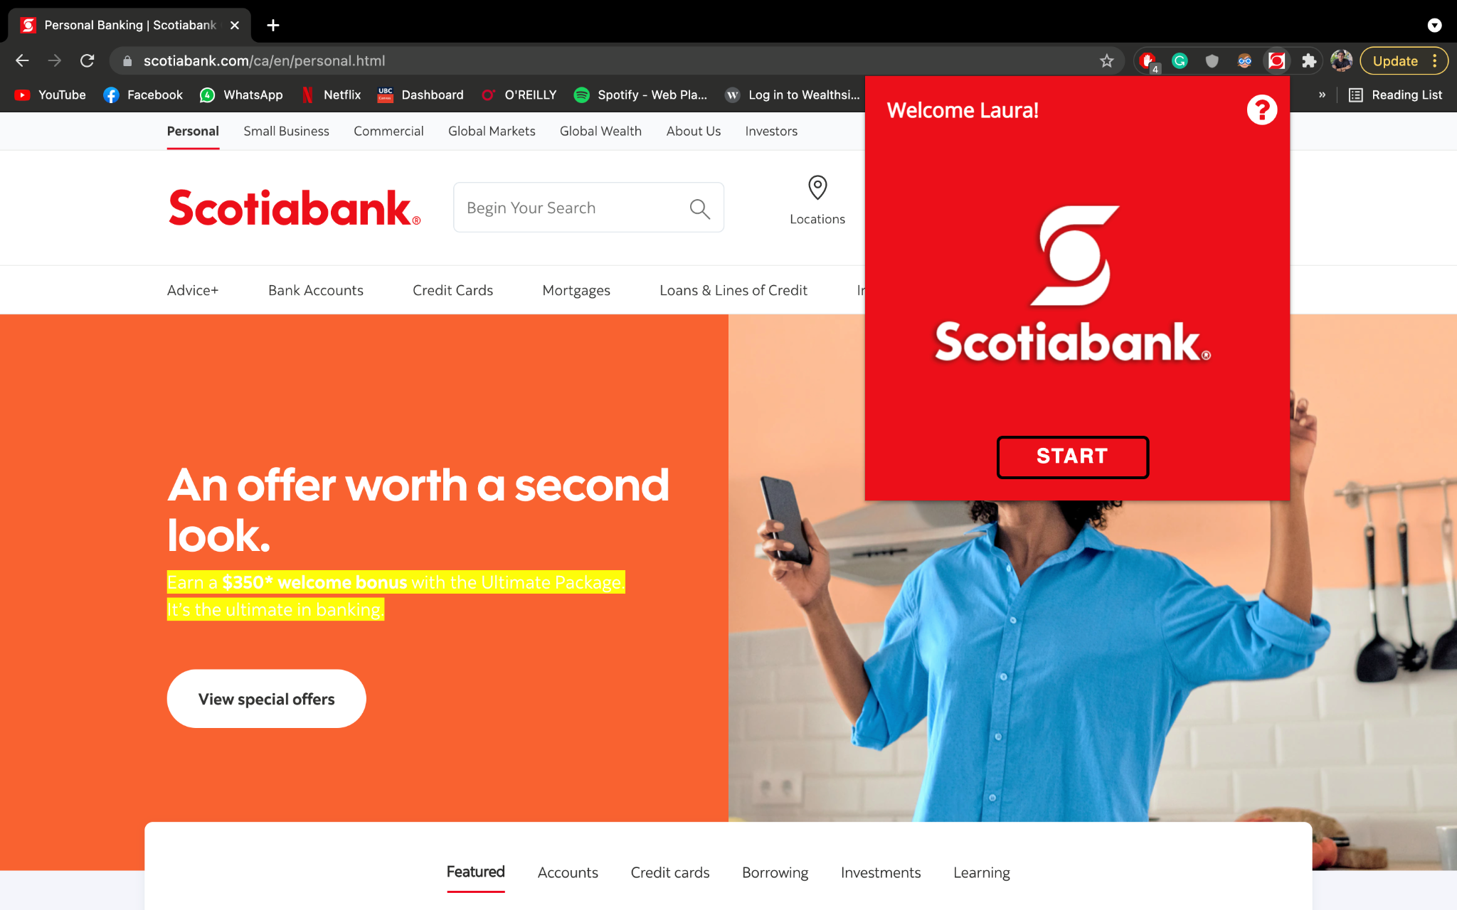
Introducing

Slide 4

User Interface Demo
User Journey
Question on feature familiarity
Welcome/Start Page
Instructions
App Workflow
Question on feature familiarity
Yes
Welcome/Start Page
Resource Page
No
FAQ Page

Slide 5
TECH STACK & HOW IT WORKS
Chrome Extension
Frontend
Backend
HTML/CSS
Chrome.js
Python
Javascript
1.
2.
3.
EasyScotia uses Python to scrape existing Scotia FAQ page
Cross-references content on banking service page user is on
Highlights respective content on web page to guide user to provide interactive guide using Javascript
Notes:
As you can see from the recording, in the backend we used Python to build a custom web scraping algorithm to grab all the FAQs from the Scotiabank website. We then use that data to cross reference the text that is on the page that the user is on, and it highlights the keywords to create an interactive tutorial for the user on how to use the service they are on.
To put the whole thing together, we made a Scotiabank themed Chrome Extension that would be prompted to install when the user logs onto their banking web portal.

Slide 6
POTENTIAL BENEFITS
01
Higher Feasibility
EasyScotia is an easy to use chrome extension that automatically detects useful content across pages, preventing the hassle of research and aided support.
02
Data Analysis
Data collection through EasyScotia can be leveraged by Scotiabank to aid their data analytics services for their other functional departments..
03
Consumer Confidence
EasyScotia can help impede technophobia among the targeted demographic and instill confidence toward digital financial services.
04
Additional Revenue
Added customer security can lead to a potentially larger consumer base along with cross-platform promotion for the security implications.

Slide 7

FURTHER STEPS
Multi-Service Implementation
Rewards Program
Licensing
EasyScotia can be extended beyond just the Scotiabank desktop webpages. A possible implication of this is to integrate the extension directly into the mobile banking app.
Provide a well-refined rewards program to encourage the users to avail the extension. One potential method to do this is integrating the extension into the pre-existing SCENE loyalty program.
EasyScotia has immense possibility of collaboration since it’s unique to the online financial services provided by Scotiabank, this could lead to licensing deals with other banks as well as potential M&A leads.

